Slide 1

Digital Forensics
Exercise 5
Compiled by
M S Anand
Department of Computer Science

Slide 2

Digital Forensics
Exercise 5
Implement a file carver program in C which will carve out the following types of files:
.BMP
.JPG
The input to the program is a raw image (using dd) which contains a number of files.
01/04/2022

Slide 3
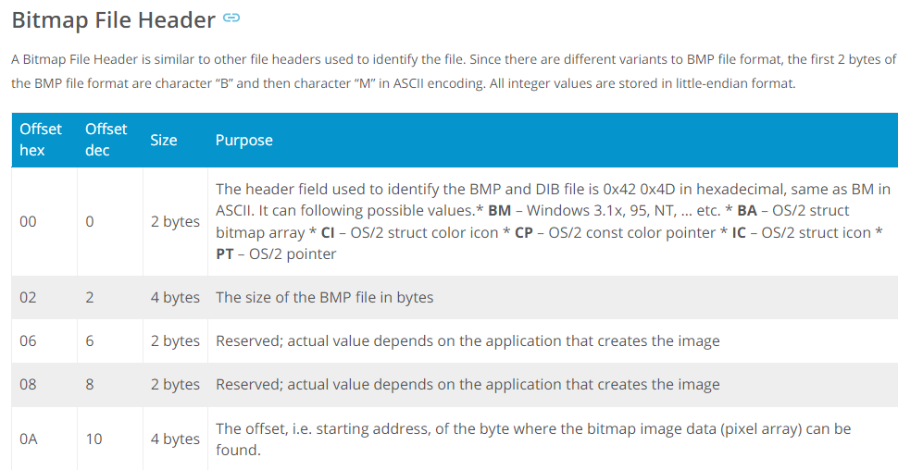
Digital Forensics
Exercise 5
01/04/2022

Slide 4
Digital Forensics
Exercise 5
JPEG files (compressed images) start with an image marker which always contains the marker code hex values FF D8 FF. It does not have a length of the file embedded, thus we need to find JPEG trailer, which is FF D9.
01/04/2022

Slide 5
THANK YOU
M S Anand
Department of Computer Science Engineering
anandms@yahoo.com

